Slide 1


WEAPONS DETECTION FROM BODY-CAM
HEN GOLYAN, AVIV HELLER, AFIK SUISSA
GENERATIVE AI AND COMPUTER VISION, SEMSTER A

Slide 2

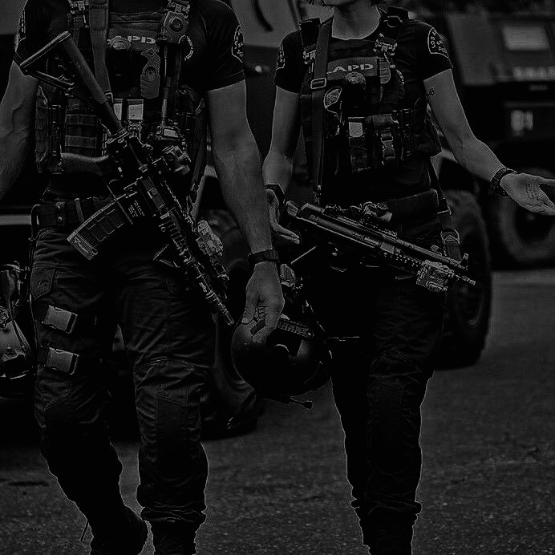
PROJECT REVIEW
Detect weapons from body worn cameras for military and public safety applications.
enhanced situational awareness and efficient post event analysis.
For some images, we applied bodycam distortions and a 'realism pass’.
Core Model: YOLOv8s (Small)
Hybrid Training Strategy:
Combining real world labeled hand surgical frames with AI Generated Synthetic Weapon Data (Diffusion based Image compositing).

Slide 3
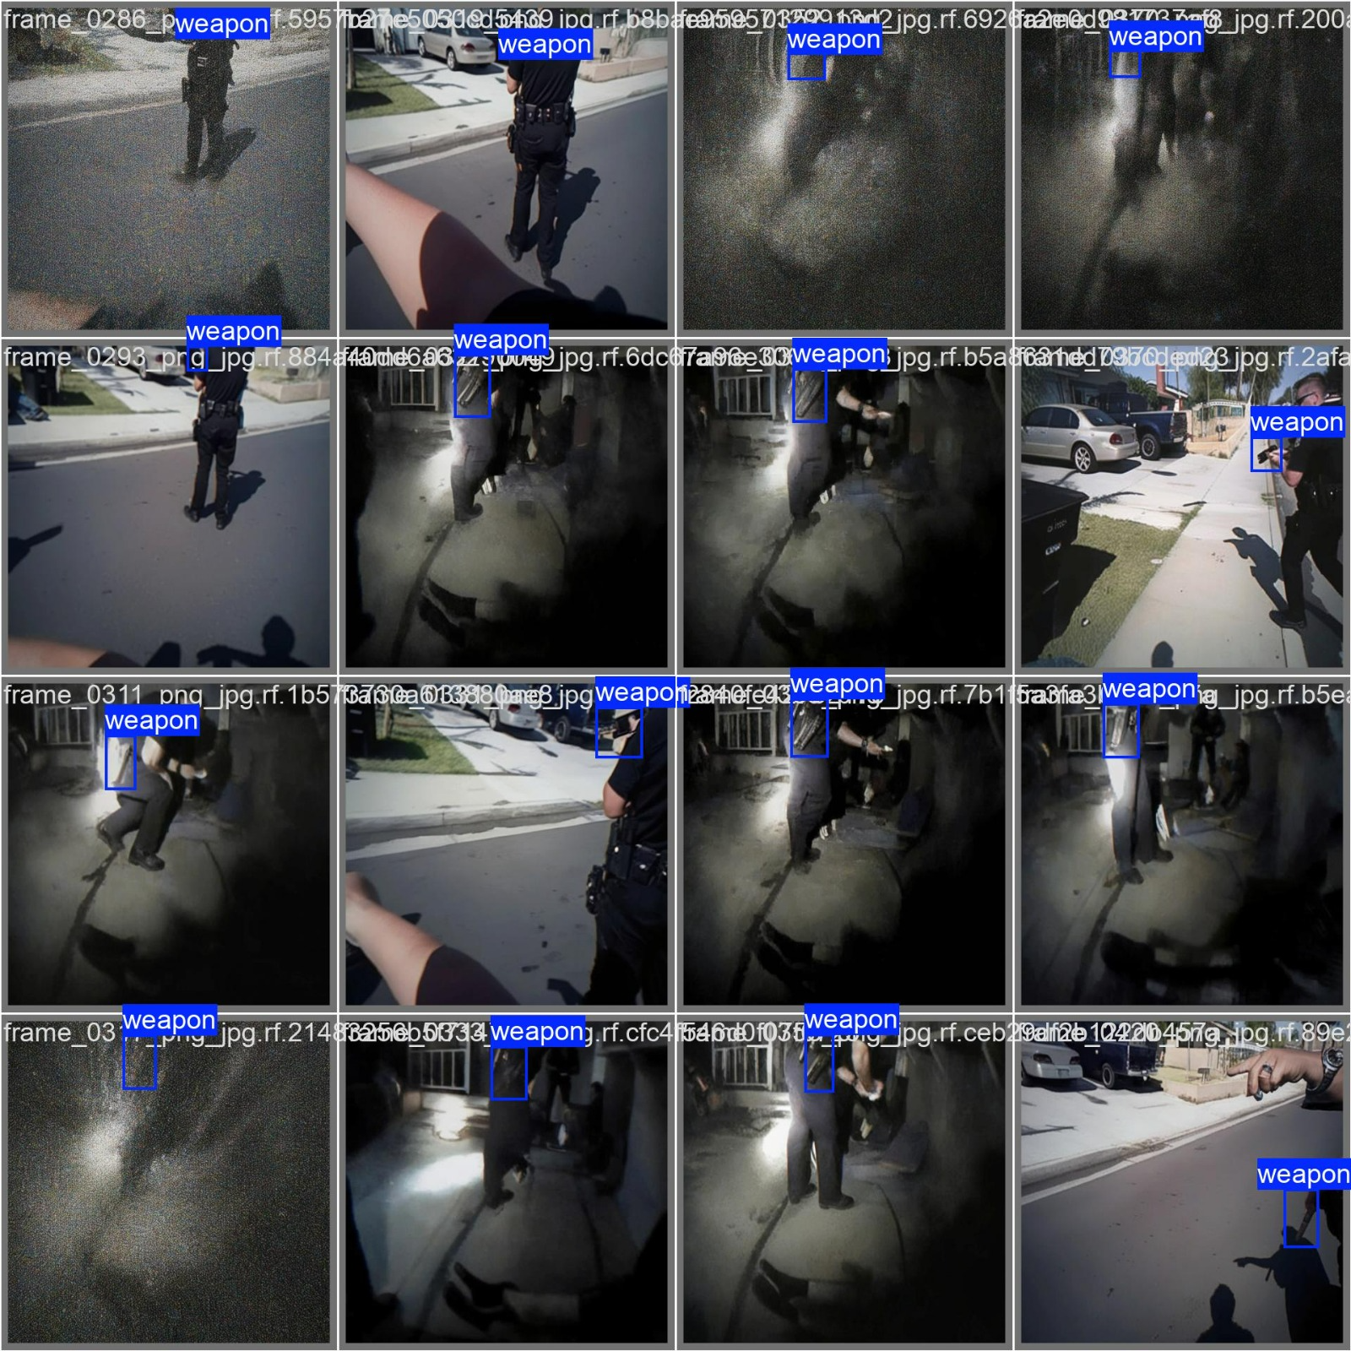
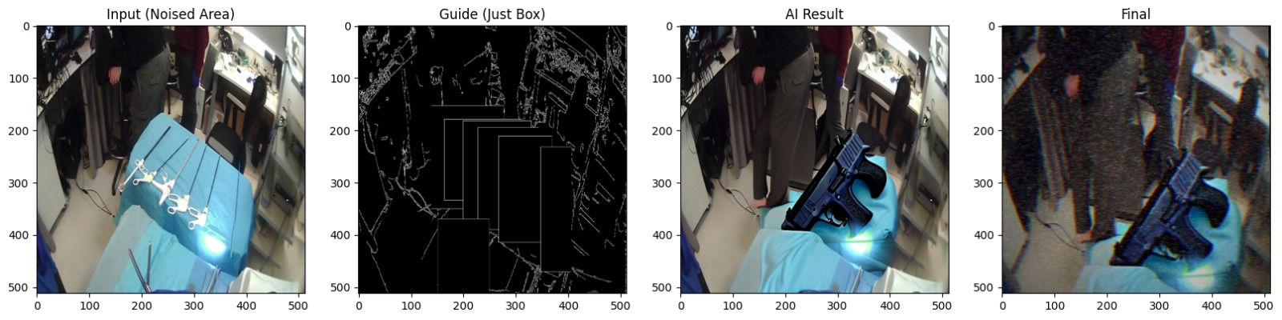
PROJECT REVIEW
Data
Augment existing dataset: introduce distortions to existing surveillance images with already labeled weapons.
Compositing- used to overlay real weapon images onto various backgrounds, creating a high quality synthetic dataset with precise labeling

Slide 4
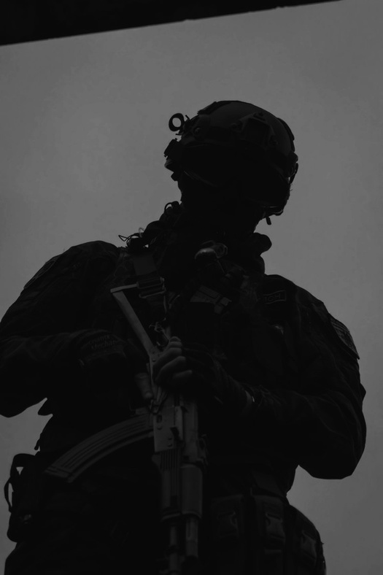
ACHIEVEMENTS & NOVELTY
Bodycam conditions- Implemented a GenAI based detection model that identifies weapons under challenging environmental conditions.
Synthetic Data- Created a custom dataset using Image compositing and AI driven weapon synthesis, applying distortions to perfectly mirror the unique visual challenges of real world bodycam footage.
At the end of our project, we reached a point where our model receives an image that is not in the training data, it can identify the weapon despite the noise in the image at high percentages (an example will be shown in the results slide).

Slide 5
REVIEW METHODOLOGY
The project process:
Step 1
Preparing the data for the model, using real data and Synthetic Data.
Including validation process confirming that the dataset is consistent, clean and error free.
Step 2
Model selection and training, Used YOLOv8s (Small) Model.
Step 3
Evaluation Metrics, Assessed performance using industry-standard metrics: mAP@0.5, Precision, and Recall.
Efforts:
Since we couldn't find a good dataset for bodycams, we created our own. We took high quality images of weapons, cleaned them manually, and added effects like Fisheye and Motion Blur to make them look like real body-cam footage.
We also used Image compositing to 'plant' weapons into new scenes to give the model more examples to learn from.

Slide 6
RESULTS
Before:
From interim presentation, training on 500 augmented images only.
After:
Improved dataset - contained augmented motion blur and image composition of weapons from bodycam shots (total of 15600 images).
The results are after 50 epochs.
Metric | Value
mAP50 | 0.532 (53.2%)
Precision | 0.692 (69.2%)
Recall | 0.508 (50.8%)
Inference Speed | 5.4 ms per image (T4 GPU)
Metric | Value
mAP50 | 0.979 (97.9%)
Precision | 0.962 (96.2%)
Recall | 0.946 (94.6%)
Inference Speed | 4.5 ms per image (T4 GPU)

Slide 7
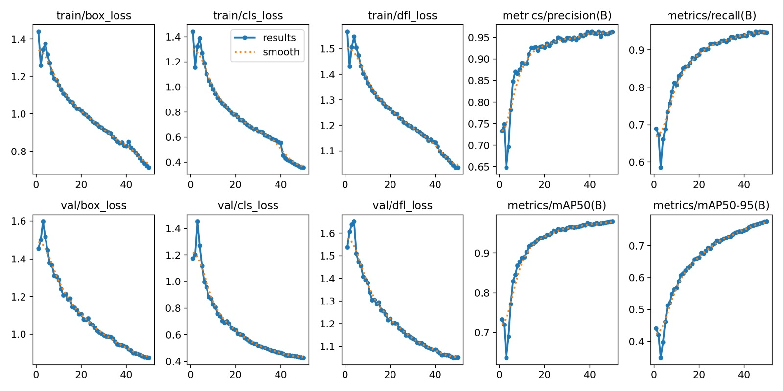
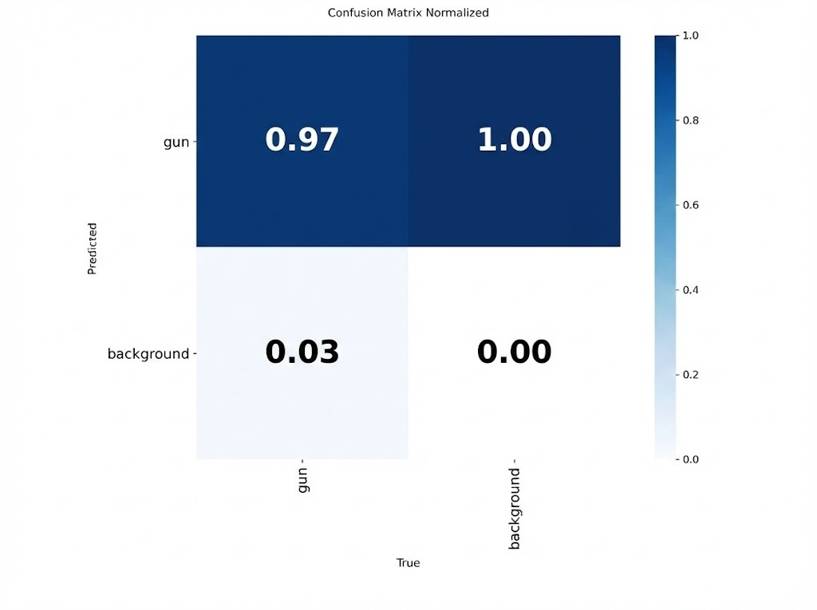
RESULTS

Slide 8
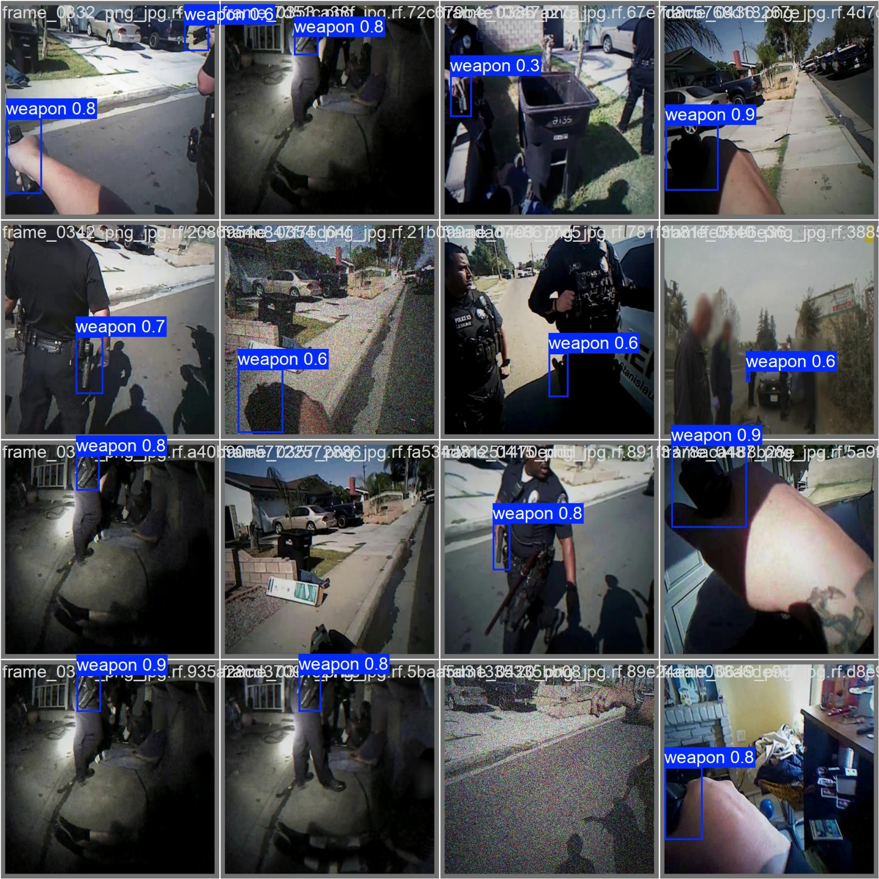
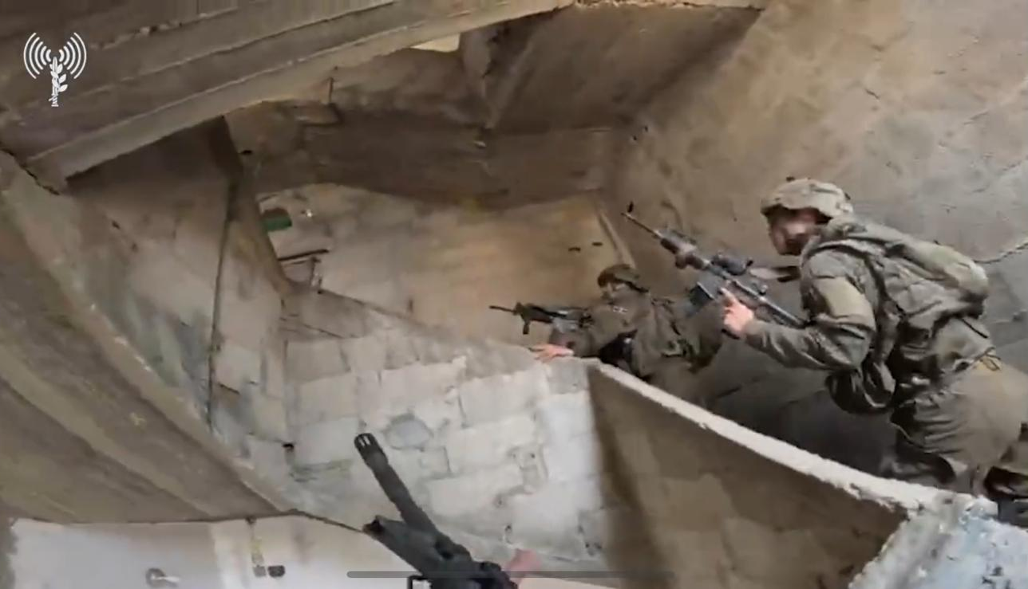
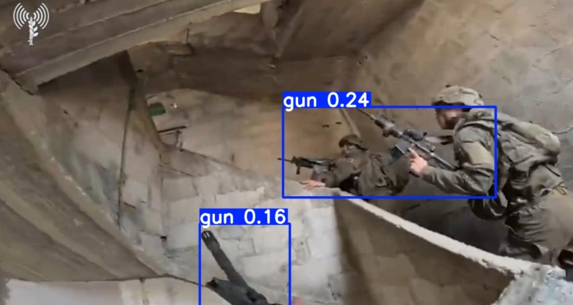
RESULTS
Unseen image:
Result:

Slide 9
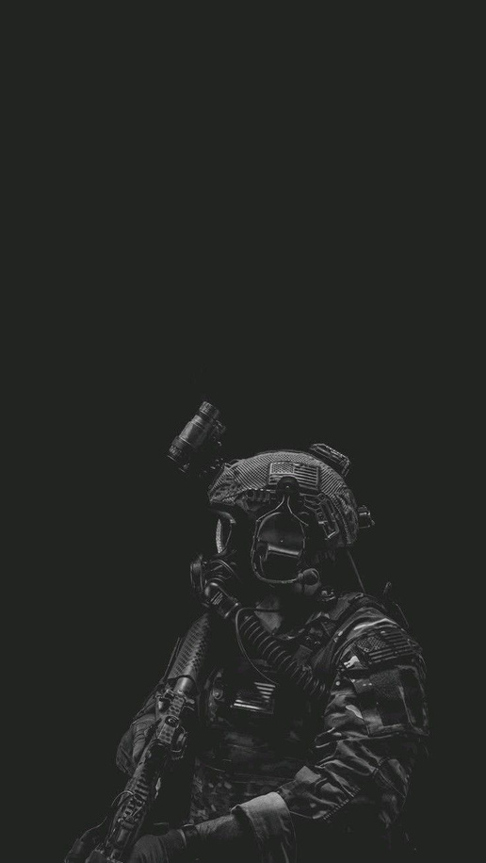
CONCLUSION
We did success to receive the results we wish for, new image outside the training data get weapon detection from the model.
we learned from our project findings that Image Compositing is more effective than Stable Diffusion for unusual contexts, such as operating rooms or card games. This approach ensured higher data quality and more accurate labeling.
In the future, we aim to improve the model to support real time bodycam video analysis, rather than relying solely on still images as in the current approach.

Slide 10

THANK YOU

